Slide 1


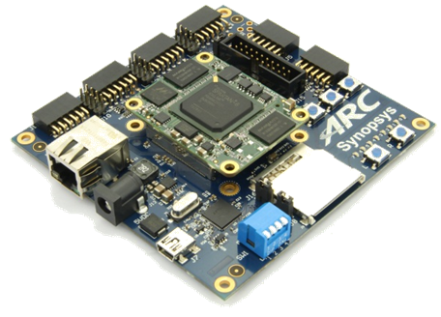
領先創新·
·超越自我
2019 Synopsys ARC盃電子設計競賽

Slide 2

SMART FIREFIGHTER
UETer: DANG Hai Ninh & VU Huong Giang
SISLAB VNU University of Engineering and Technology (VNU – UET)
August 2019

Slide 3
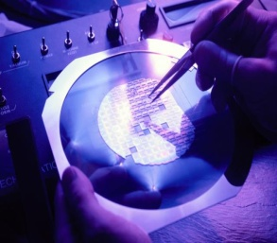
Agenda
Motivation and objectives
Design implementation
Test Results
Summary

Slide 4
Agenda
Motivation and objectives
Design implementation
Test Results
Summary

Slide 5
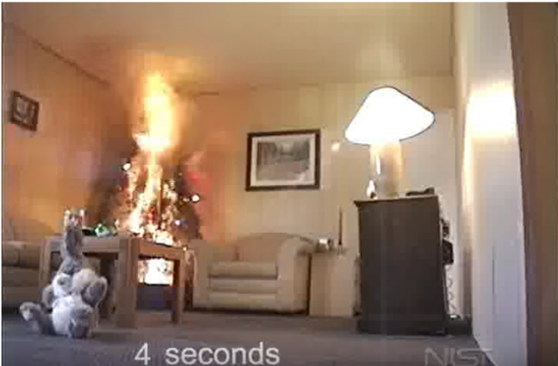
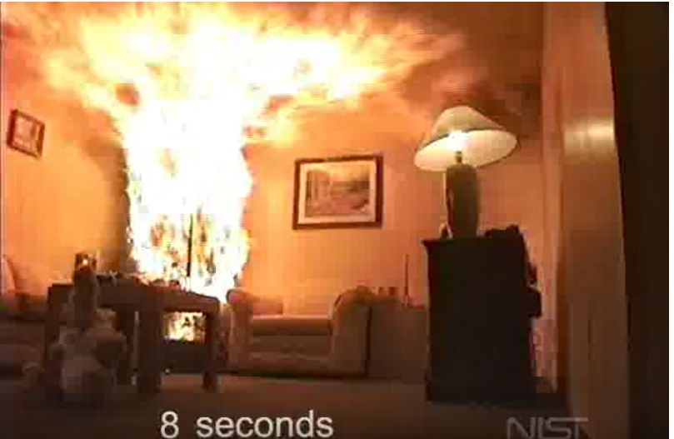
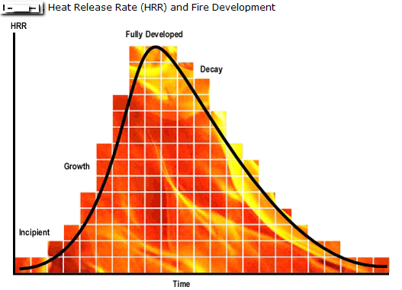
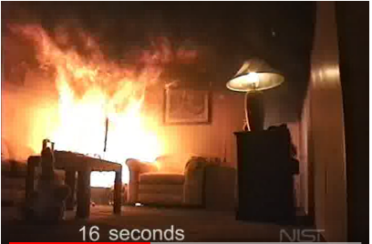
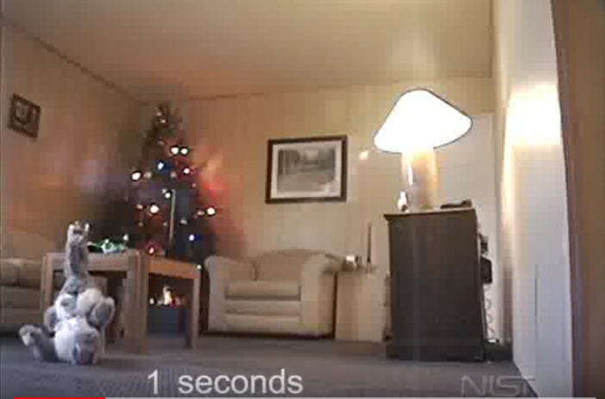
Motivation
Fire growing rate are exponential
Quick methods to identify and extinguish fire save lives and properties

Slide 6
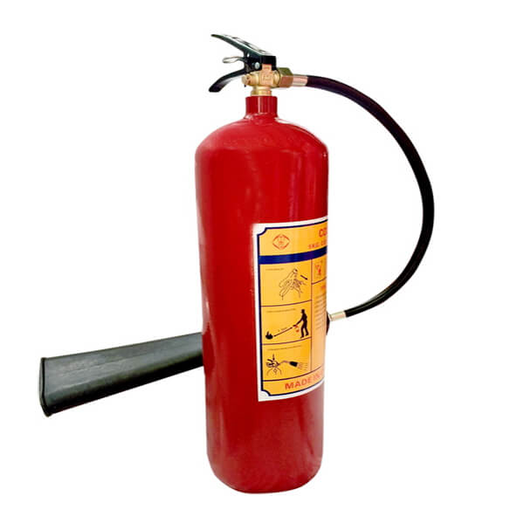
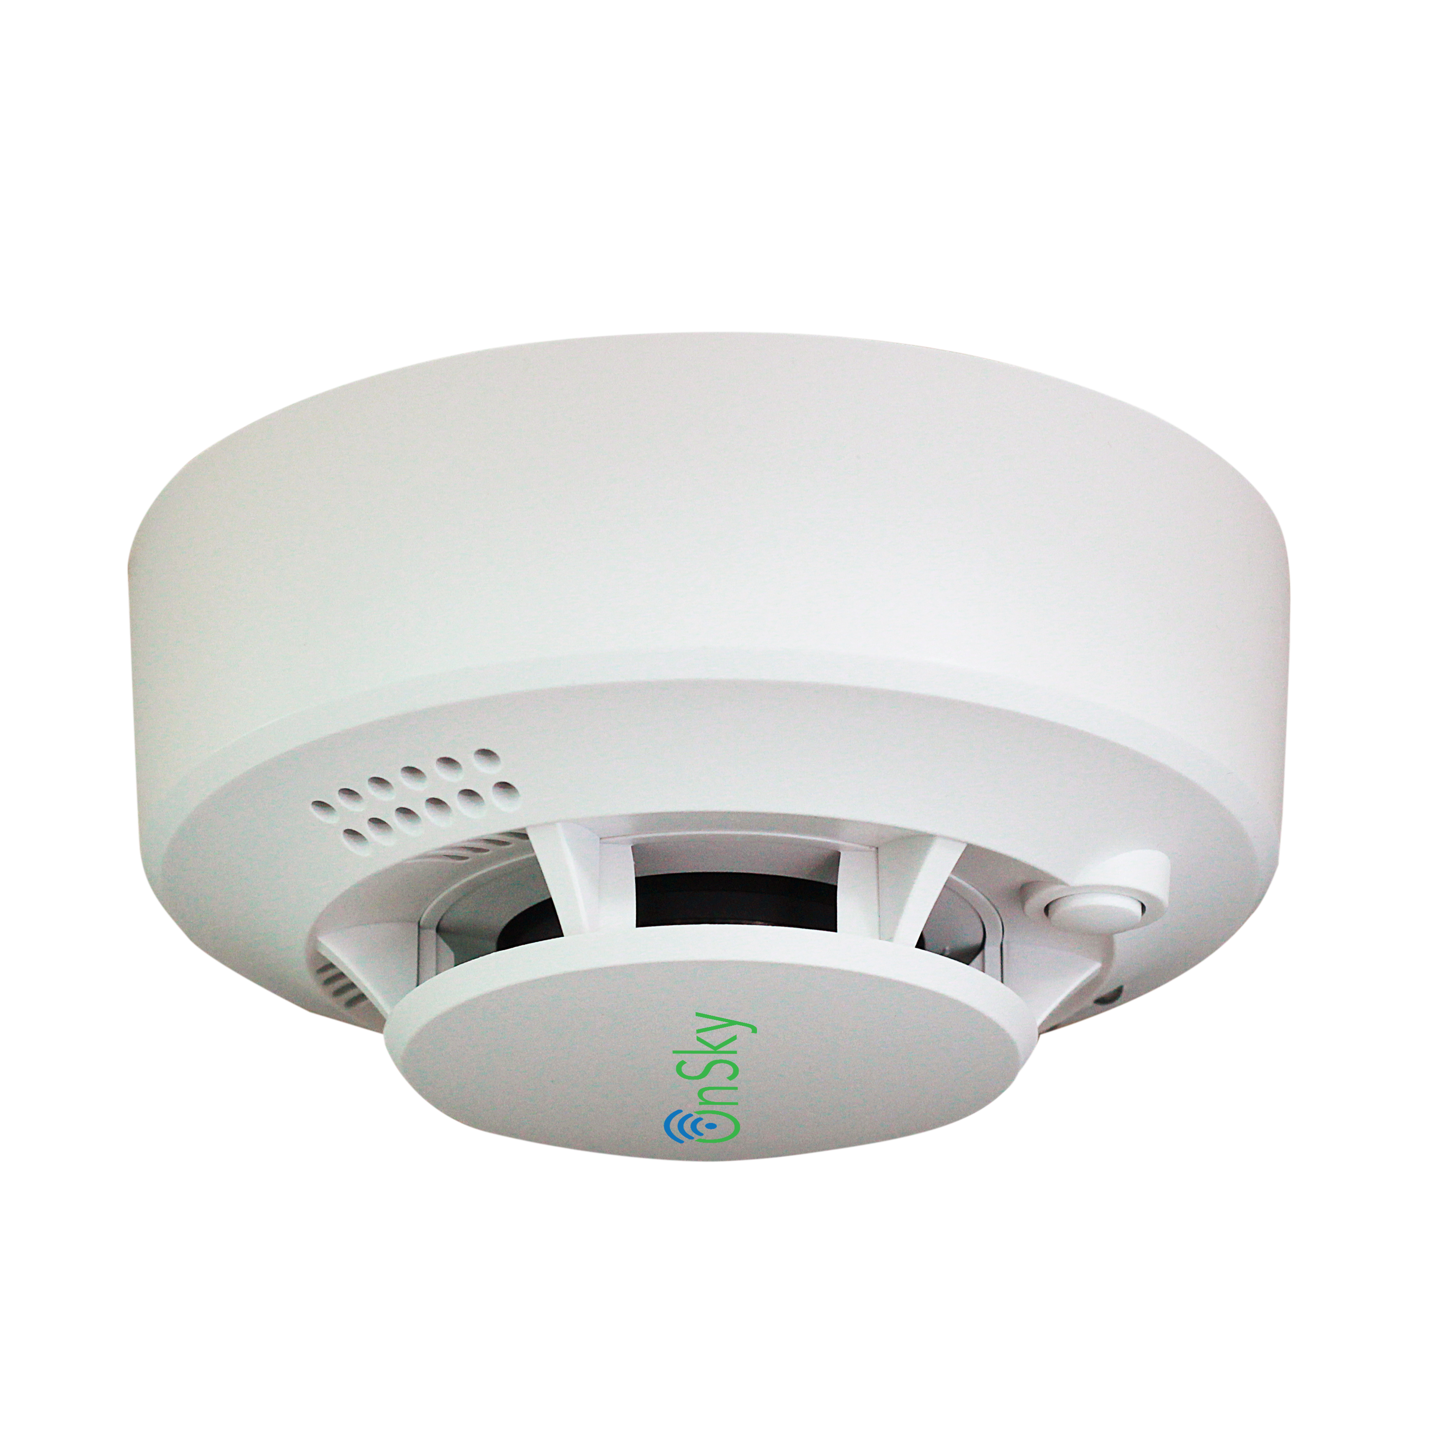
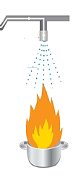
Motivations (cont.)
Traditional methods
Smart firefighter
Quick and accurate detection of flame location.
Spray water flow to the fire correctly, while keeping other areas dry spear.
Can be mobility.
Expensive
Fire extinguisher
Heavy
Limited visibility
Smoke sensor:
Slow detection
No location of flame
Wide water spray nozzle:
Waste water
Causing damage to other furniture

Slide 7
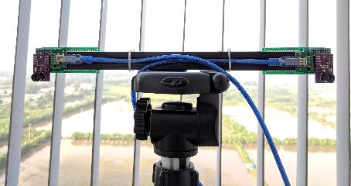
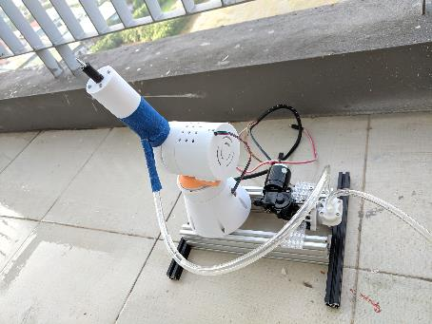
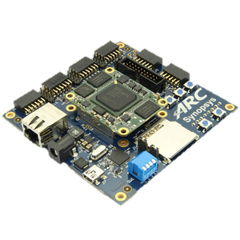
Our objective: low-cost smart fight fighter
Fire detection: Low-cost InfraRed Sensors
Autonomously detect and extinguish the fire
Useful in certain types of incidents where the environment will be very dangerous for the humans
3D-printed robot arm
Warning of danger, usually a loud noise
ARC EM Starter kit for algorithms & controls

Slide 8
Agenda
Motivation and objectives
Design implementation
Test Results
Future plan
Summary

Slide 9
Processing flow
Start
IR camera send hottest pixel to EMSK
NO
EMSK calculates the distance to the heat source and determines "IS IT A FIRE?”
YES
The two axis robot arm sprays water to put out the fire

Slide 10
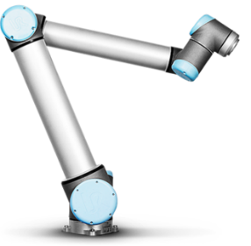
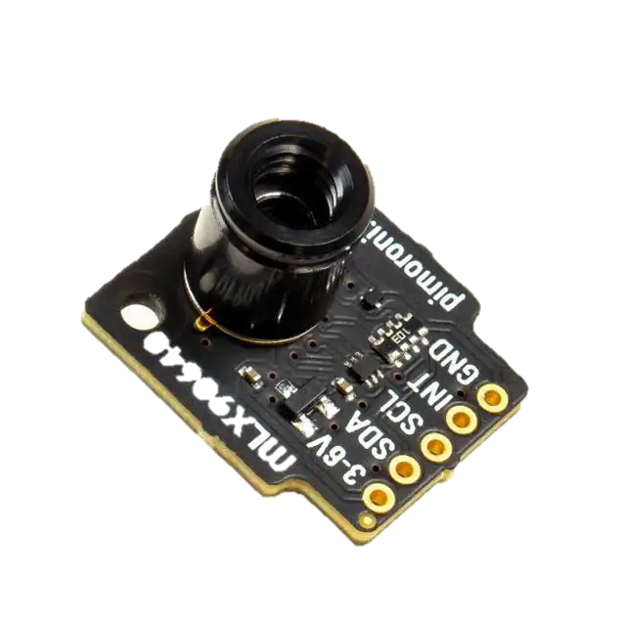

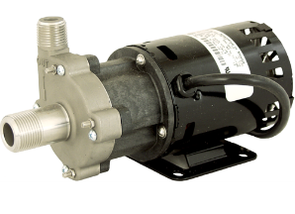
System components
2 stepper motor
UART
Move spray nozzle
Flame directions
2 axis robot arm
UART
H bridge
Flame directions
Spray water
Calculate flame locations
Water pump
2x thermal sensor 32x24 pixel
FOV: 55°x35°
ARC EM Starter Kit
Two Low-cost Infrared sensors
3D printed robot hands controlled by step motors
One water pump

Slide 11
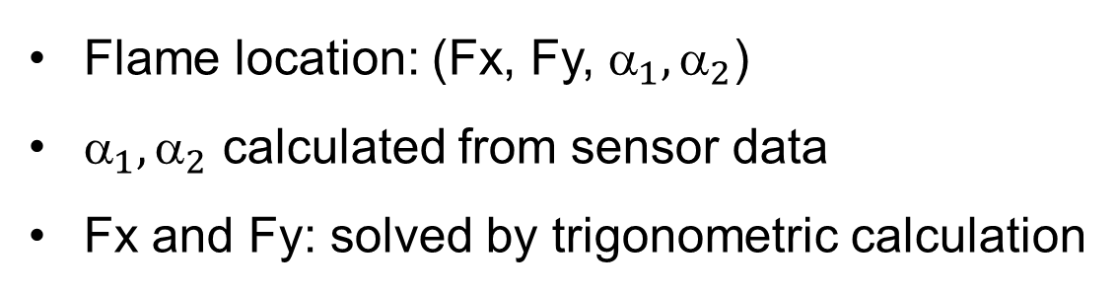
Flame Detection
Angle calculation from sensors
Detection range: 4mx4.4mx4.4m
Hottest pixel: xh = 2, yh = 1
- X angle: α = (55/32)*xh
- Y angle: β = (35/24)*yh
- 2 sensor: α₁, α₂, β₁, β₂
Flame location: (Fx, Fy, ${\text{}}_{1},{\text{α}}_{2}$)
${\text{}}_{1},{\text{α}}_{2}$ calculated from sensor data
Fx and Fy: solved by trigonometric calculation

Slide 12
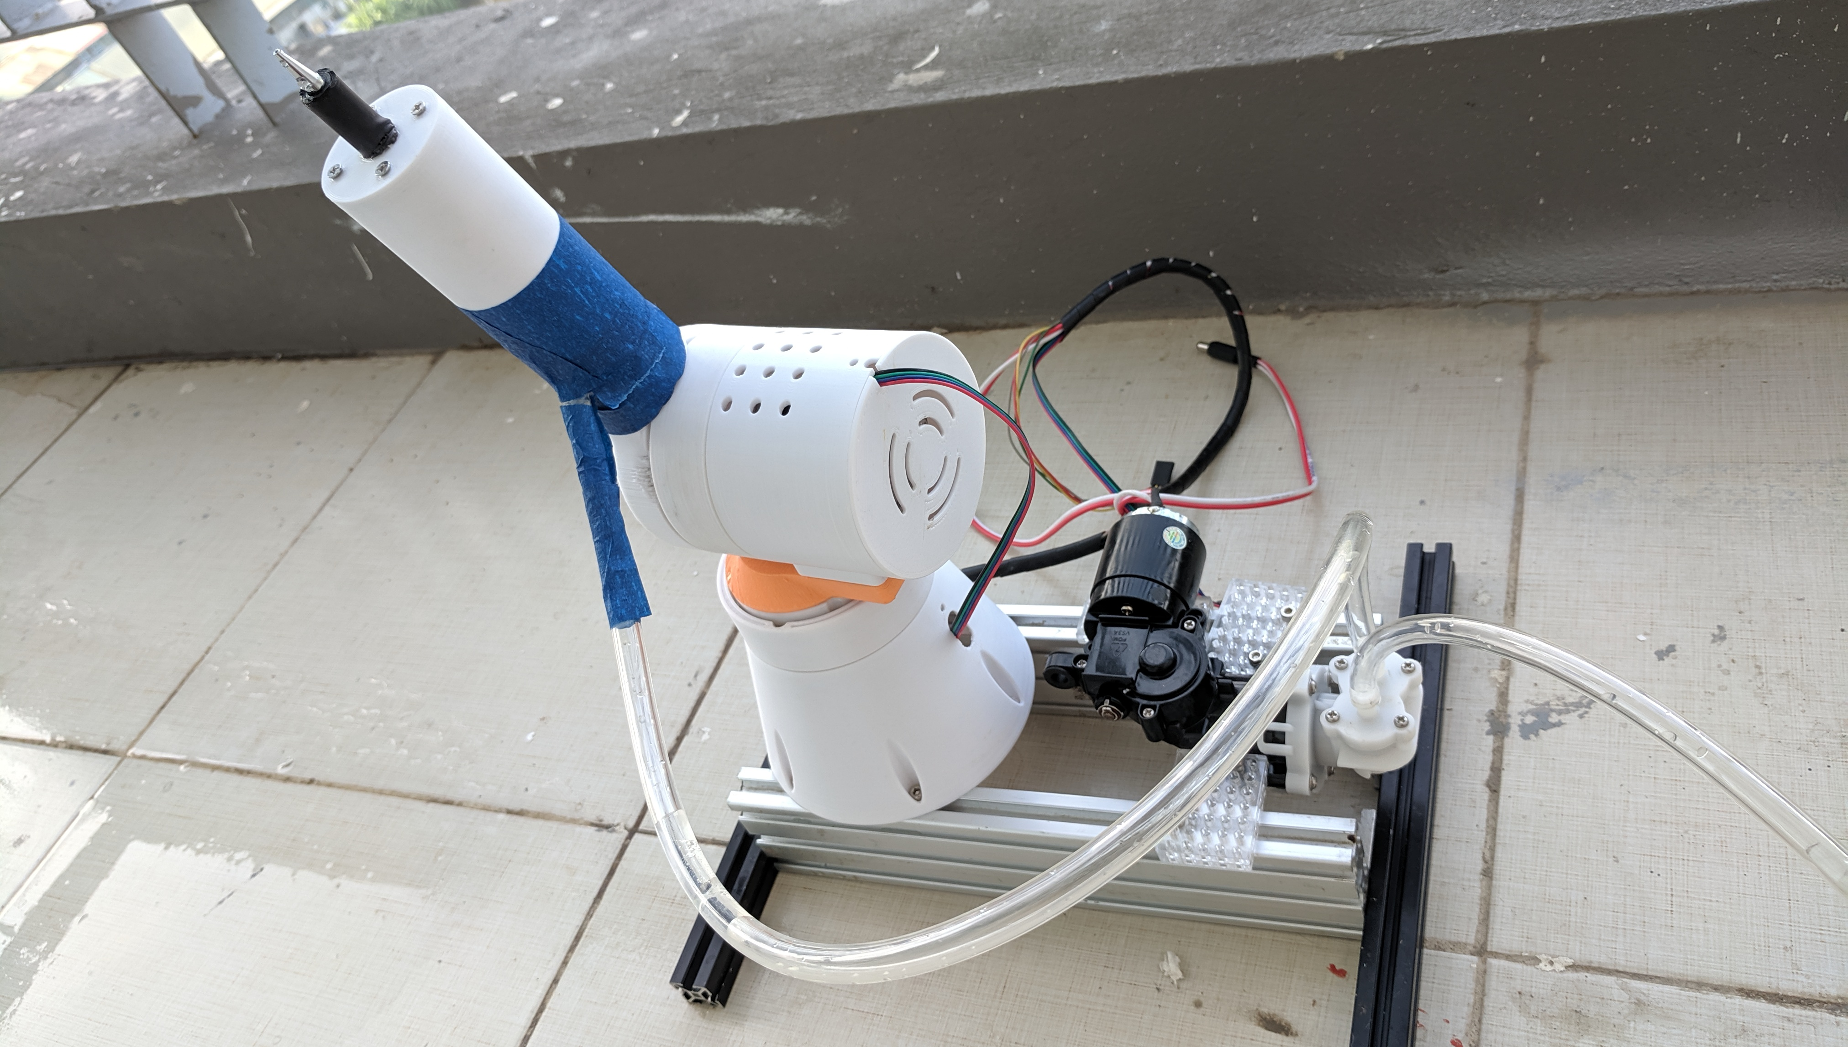
3D-printed robot hand for spraying water
Planetary Gears
12v High pressure pump

Slide 13
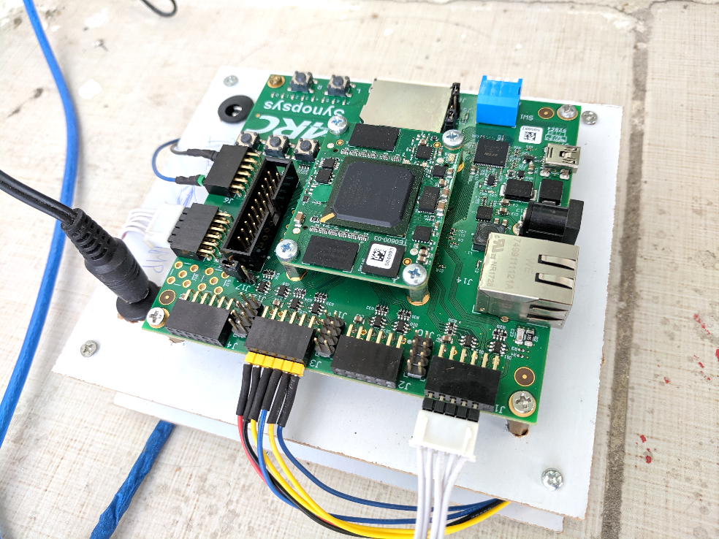
ARC EM Starter Kit connection
J6 : Relay module for water pump control
J3 : 2 Stepper driver module.
J1 & J5 : 2 IR camera module (using UART).

Slide 14
Agenda
Motivation and objectives
Design implementation
Test Results
Future plan
Summary

Slide 15
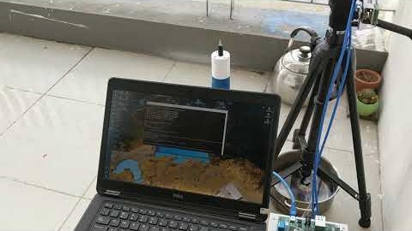
Demonstration setup

Slide 16
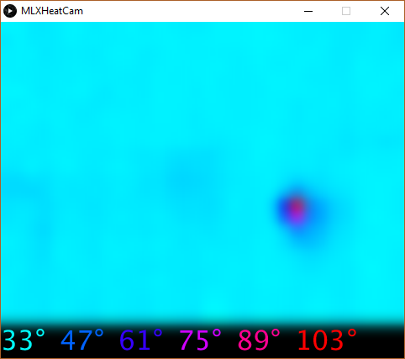
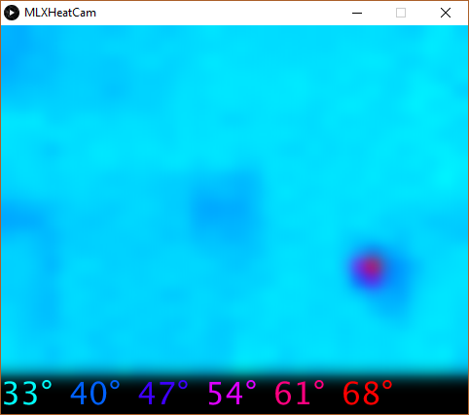
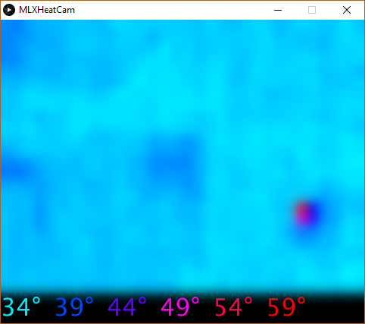
Test Results – Candle flame visualization
1m
2m
3m

Slide 17
Agenda
Motivation and objectives
Design implementation
Test Results
Future plan
Conclusion

Slide 18
Conclusions
Fire grows very fast in home environment
Industrial Smart Fight Fighter are expensive
Our proposal: Low-cost Smart Fight Fighter
Low-cost IR sensor for fire detection
3D-Printed Robot hands for water control for extinguishing fire
ARC EM Starter Kit for algorithm development & control
Future work
Multi-sensor nodes with wireless connections
Embedded AI for fire classification

Slide 20
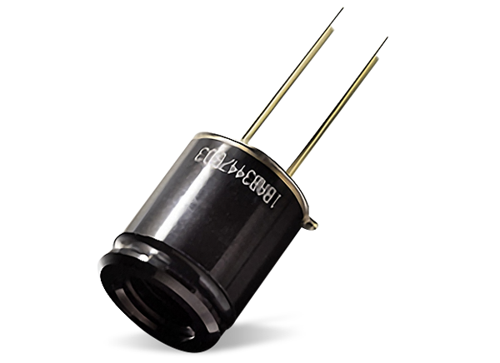
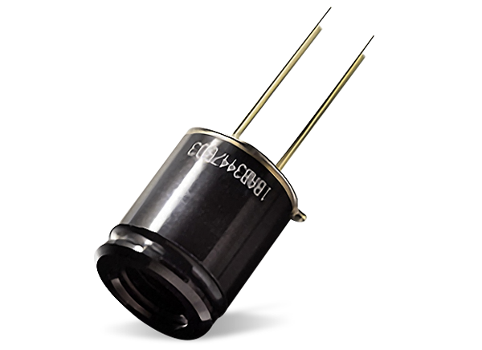
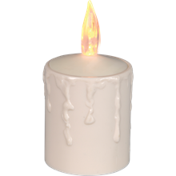
IR sensor
40cm
α₂
α₁
Fx
IR sensor
50cm
Fy
Ground

Slide 21
IR sensor
40cm
α₂
α₁
Fx
IR sensor
50cm
Fy
Sensor wall
Ground

